Slide 1
SHOBHIT SHARMA
ROLL NO. : 2200290140150
SUPERVISOR : MS.KOMAL SALGOTRA

Slide 2
ONLINE GROCERY
REACT JS

Slide 3
INTRODUCTION
In recent years, the landscape of retail has undergone a significant transformation with the advent of online shopping platforms. Among these, online grocery shopping has emerged as a particularly prominent sector, offering consumers the convenience of purchasing essential goods from the comfort of their homes. However, despite the convenience offered by these platforms, there remain challenges in providing seamless user experiences that rival the traditional in-store shopping experience.
This introduction sets the stage for exploring how the integration of React, a popular JavaScript library for building user interfaces, can enhance the online grocery shopping experience. React's component-based architecture and virtual DOM offer a powerful framework for developing interactive and responsive web applications, making it an ideal choice for improving user interfaces in e-commerce platforms.
The primary objective of this project is to develop a user-friendly interface for an online grocery store using React, focusing on improving navigation, product search, and checkout processes. By leveraging React's capabilities, the project aims to address common pain points in online grocery shopping, such as cumbersome navigation, inefficient search functionalities, and complex checkout processes.

Slide 4
INTRODUCTION CONT..
Through a comprehensive literature review, this project will explore the evolution of online grocery shopping, examine the role of user experience in e-commerce, and discuss the significance of React in modern web development. The methodology section will outline the selection of technologies and tools, system architecture, and development process employed in building the online grocery store application.
The subsequent sections of this project will delve into the design, implementation, and evaluation of the online grocery store application, highlighting key features such as intuitive user interface design, enhanced product search functionality, and seamless checkout experience. Real-world examples and case studies will be used to illustrate the practical application of React in improving user experiences in online grocery shopping platforms.
In conclusion, this project aims to demonstrate the potential of React in elevating the online grocery shopping experience, ultimately enhancing user satisfaction and engagement on the platform. By combining the principles of user-centered design with the capabilities of React, this project seeks to contribute to the ongoing efforts to innovate and improve the e-commerce landscape.

Slide 5
OBJECTIVE
To develop a user-friendly interface for an online grocery store using React, focusing on improving navigation, product search, and checkout processes.
To leverage React's component-based architecture and virtual DOM to enhance responsiveness and interactivity, ensuring smooth interactions across various devices and screen sizes.
To implement intuitive design layouts and visual elements that simplify the browsing and selection process for users, thereby improving the overall user experience.
To integrate efficient search and filtering options using React's state management capabilities, allowing users to quickly find desired products and streamline the shopping process.
To optimize the checkout process by integrating secure payment gateways and minimizing steps, reducing friction and improving conversion rates.

Slide 6
OBJECTIVE CONT..
To provide real-time updates and notifications to users regarding order status, delivery schedules, and promotions, enhancing engagement and satisfaction.
To adhere to best practices in web development, including responsive design principles, accessibility standards, and performance optimization techniques.
To evaluate the effectiveness of the implemented features through user experience evaluation, performance analysis, and comparison with existing online grocery shopping platforms.
To document the development process, methodologies, and findings to contribute to the knowledge base of utilizing React in enhancing e-commerce user experiences.
To identify opportunities for future enhancements and optimizations based on user feedback and emerging technologies, ensuring continuous improvement of the online grocery shopping platform.

Slide 7
DESIGN
User Interface Design:
Visual Design Elements: Implement visually appealing design elements such as color schemes, typography, and imagery to create an engaging and memorable user interface.
Navigation Structure: Design an intuitive navigation structure with clear categories, menus, and navigation bars to help users easily find products and navigate through the online grocery store.
Product Search Functionality:
Search Bar Implementation: Design and implement a prominent search bar at the top of the interface to allow users to quickly search for specific products by keywords or categories.
Filtering Options: Incorporate filtering options such as price range, brand, dietary preferences, and product attributes to help users refine their search results and find relevant products efficiently.
Checkout Process:
Shopping Cart Management: Design a user-friendly shopping cart interface that displays the selected products, quantities, and prices. Provide options to edit quantities, remove items, and apply discount codes.

Slide 8
DESIGN CONT..
Payment Gateway Integration:
Design a seamless and secure payment process with integrated payment gateways, allowing users to complete transactions securely using various payment methods such as credit/debit cards, digital wallets, or cash on delivery.
Responsive Design:
Ensure responsive design principles are applied to the interface, making it accessible and optimized for various devices including desktops, laptops, tablets, and smartphones.
Implement fluid layouts, flexible grids, and media queries to adapt the interface to different screen sizes and orientations, providing a consistent and visually appealing experience across devices.
Accessibility:
Ensure compliance with accessibility standards such as WCAG (Web Content Accessibility Guidelines) to make the online grocery store accessible to users with disabilities.

Slide 9
MODULES
User Authentication and Authorization:
Implement user registration, login, and logout functionalities.
Manage user authentication tokens and session management.
Enforce authorization rules to restrict access to certain features based on user roles.
Product Catalog Management:
Create, update, and delete functionalities for product listings.
Manage product categories, attributes, and pricing information.
Implement image uploading and management for product images.
Search and Filtering:
Develop search functionality to allow users to search for products by name, category, or attributes.
Implement filtering options to refine search results based on price range, brand, dietary preferences, etc.
Integrate autocomplete suggestions for search queries to enhance user experience.

Slide 10
MODULES CONT..
Shopping Cart and Checkout:
Manage shopping cart functionalities including adding, removing, and updating items.
Calculate subtotal, taxes, and total price dynamically based on cart contents.
Integrate secure payment gateways for processing payments and completing checkout transactions.
User Profile and Order Management:
Allow users to view and manage their profiles, including personal information, addresses, and payment methods.
Provide order history and order tracking functionalities for users to monitor the status of their orders.
Enable users to leave feedback, ratings, and reviews for products they have purchased.
Responsive Design and Cross-Browser Compatibility:
Ensure the application layout and components are responsive and adapt to different screen sizes and devices.
Test the application on various web browsers and devices to ensure cross-browser compatibility and consistent user experience.

Slide 11
PROJECT OUTCOME
Enhanced User Experience:
The primary outcome of the project is to deliver an online grocery shopping platform with an enhanced user experience. Users will benefit from a user-friendly interface, intuitive navigation, efficient product search, and seamless checkout process, leading to increased satisfaction and engagement.
Improved Accessibility:
The project aims to improve accessibility by implementing features such as keyboard navigation, screen reader compatibility, and adherence to WCAG standards. This ensures that the online grocery store is accessible to users with disabilities, promoting inclusivity and usability for all.
Optimized Performance:
The application will be optimized for performance, with fast loading times, responsive design, and efficient resource utilization. Performance optimization techniques such as lazy loading, caching, and minimizing server requests will contribute to a smooth and responsive user experience.

Slide 12
PROJECT OUTCOME CONT…
Scalability and Flexibility:
The project outcomes include a scalable and flexible architecture that allows for easy maintenance, updates, and future enhancements. Modular components, clean codebase, and adherence to best practices in web development ensure that the application can accommodate growth and changes over time.
Secure Transactions:
The integration of secure payment gateways and implementation of best practices in security ensure that user transactions are conducted safely and securely. This instills trust and confidence in users, encouraging them to complete purchases on the platform.
Documentation and Knowledge Transfer:
Comprehensive documentation will be provided, including codebase documentation, user guides, and maintenance instructions. This facilitates knowledge transfer and ensures that stakeholders have the necessary resources to understand, use, and maintain the application effectively.

Slide 13
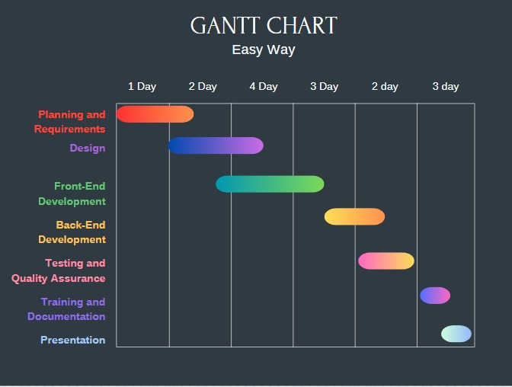
GANT CHART

Slide 14
THANKYOU..

